Slide 1
FINDING THE RIGHT CANDIDATES AND RETAINING THEM
Dr Lakshmi Prasad J
HOD - Dept of Hospital Administration
Addl Med Supdnt
AIIMS, Bhopal

Slide 2
INDIA SALUTES HCWs
Notes:
Country has recognised and encouraged HCW. Same to be applied in hospital- recognising each worker is important to encourage to deliver.
Reboot is always from where to where, over stretched, despaired, dislocated system to Robust and Vibrant system
Efforts are being made to bring nobility back to the profession.
Indian healthcare sector growth CAGR – 17% - $ 280 Bn. Medical tourism being projected high growth rate.
There has been efforts by govt to overcome this situation by announcement of special packages
For HCW – 50 lakhs Insurance and reassurance,
Stay facilities being provided at 5star hotels
Law against violence – 7 lakhs imposition, 7 years of Jail – Non bail able arrest.
In Hospital like this special efforts to be made to help employees to over come situations
Ex: Employee With cancer – efforts for welcoming him back to work

Slide 3
THE SHOW OF SOLIDARITY

Slide 4
NOBILITY OF PROFESSION
Notes:
HCW putting life on line for fighting covid crisis, Passion and commitment to care, longer working hours – occupational distress
Being away from family, old parents and children
Lack of PPE
Social stigma
Non Burial Rights
Problems – Pitting with stones, Assaults
Pre covid healthcare: Diagnosis to treatment
Now: Safety of employees, patients, Isolation
Gap in healthcare
World wide – 59 Million HCW as per 2016 WHO report
In india – 13L HCW
Doctor – 9.27 L – 1: 1445 population
Nursing staff – 1.7: 1000 population – Expected – 3: 1000 population
80% of doctors and 70% of Nurses being in private sector

Slide 5
GRIM REALITY

Slide 6
TEAM WORK IN HEALTHCARE
UNIVERSAL IDENTITY
Notes:
Changing Terminologies
Doctors/ Nurse/ Technician/ ASHA
Health care professionals
Health care workers
However there has been disparity in the mind set of the HCW
Ex: Hotels being provided for doctors accommodation, are being opposed by Nursing officer – who are accommodated with in the hospital along with other supportive staffs.
Hotel situation – 5 star hotel with 100 rooms being allocated to doctors, where the occupancy is at 40%
Nursing staying in one floor of the hospital has to share facility with housekeeping and other helping staff.
Hospital should work to overcome this mindset of differentiations among all categories. Team approach to be taken into consideration.

Slide 7
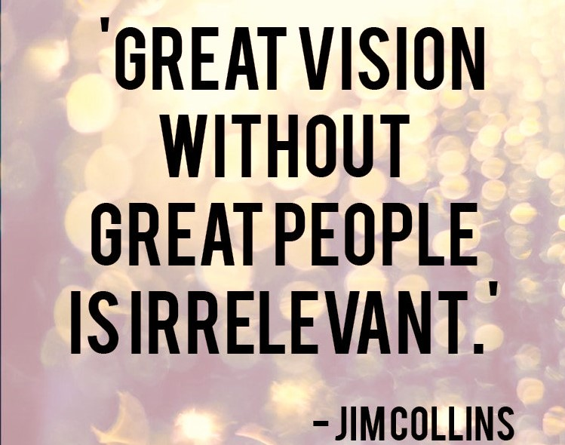
DESIGNING RECRUITMENT PROCESS
Notes:
Hospital being service industry – Interface between Provider and Customer is important.
Framing of team in vision of organization plays an important role.
Designing Recruitment process
Recruitment is not in isolated one time action, intertwined with requirement of the organization.
Job Description
MBO is a strategic management model that aims to improve the performance of an organization by clearly defining objectives that are agreed to by both management and employees.
Evaluation of Employee value proposition
What can be offered v/s what employee can give back
When to recruit? Requirements varies based on time and matrix - PERT and CPM
Active engagement from project inception – Expl – in case of Radiology dept – Machine and technology selection
1)Asking what you want in a candidate & presenting as an organisation what you have to offer - a Learning Environment ; A growing opportunity ; A best work place ;
2)Screening
3) Announcing recruitment – Announcing recruitment - Requirement specified, Media used, Time line
Social media, Linked in, professional websites, wr to look for right candiate in market
Doctors may be less proficient at routine tasks. Use of technology to ease the work. Technical staffs should be helped to move out of administrative responsibilities and providing suitable aids.

Slide 8
You don't pick talent anymore, talent picks you
EMPLOYEE VALUE PROPOSITION
Notes:
The current job market is 90% candidate-driven. That means you don’t pick talent anymore.Talent picks you. In order to make yourself their employer of choice, you have to be able to trigger your perfect candidates’ interest by differentiating your company from your competitors.You can do that by presenting your unique Employee Value Proposition (EVP). However, the Employee Value Proposition (EVP) benefits are not limited only to attracting talent. Employee Value Proposition (EVP) is also crucial for hiring the best talent that is a perfect fit for your company.

Slide 9
BELIEVING IN PAST PERFORMANCE AND BETTING ON FUTURE
Notes:
The candidate performs best in the interview may not be the best candidate for you...
In interview it is about “in many cases, job interviews are entirely disconnect from reality of day to day job,’’ - Rod Friedman, author of The Best Place to Work.
Experience: Designing opportunities for suitable person
Interview of a candidate need not be boardroom, if suitable candidate are found even with casual talk, recruitment process should happen.
At Apollo the freedom of recruitment to restriction by the steel plant – Navaratana company – to follow the process, rules, influence for their own candidates, favourers
Problems:
In general, they are not good predictors of job performance.
The interviewer may bias the process, by not knowing how to correctly or effectively interview.
The Interviewer asks the wrong questions or does not use objective criteria
Problems Occur when comparing the interviews several applicants

Slide 10
KNOW YOUR IDEAL CANDIDATE
Finally you can recruit a candidate with a right potential whether turns into performance or not?
Choosing a candidate.jpg
Notes:
Requirements varies based on time and matrix
Efforts taken for recruitment
Skill matrix with requirement of organization
Organizations should support employees with work instructions, SOP’s, Guidelines, Manuals, policies
Doctors may be less proficient at routine tasks. Use of technology to ease the work. Technical staffs should be helped to move out of administrative responsibilities and providing suitable aids.
Do you believe in yourself?
Do you accept responsibility?
Do you deliver?
Finally you can recruit a candidate with a right potential whether turns into performance or not?
You can’t finalise a swimming team without getting them into pool/ Cricket team and playing matches
Finding right candidate
Tasks of the position to be filled
What it takes to perform those tasks
Interns
Career orientation
Specific experiences & accomplishments
Work ethic & attitude
Lifelong learner
Passion
Your organization culture fit or not

Slide 11
Reel Vs. Real

Slide 12
EXTENDING OFFER
Pay and perks
Fair dealing
Growth opportunity
Partnership
Notes:
– Pay and perks
(Best in the industry???) – usually used term. Wat is best in the industry may not be best for the candidate
Fair dealing
Experience @kims/ Chhattisgarh
Negotiating with 40 yrs experience person, well settled, money not on priority, bring him to remote place, offering them what is comfortable to them, like good accommodation, health coverage, leave offers.
Review Mechanism – letting them know, how they are evaluated
Growth Opportunity – What is available to them – Opportunity for training, Higher studies, development of Skills
Partnership – On Long run, we cannot retain as employees, we have make partner with star quality team

Slide 13
ON BOARDING PROCESS
Notes:
Verification of credentials and health status
Induction programme – The Mission statement of the organization should be mission of the staff
Training of required skills for the job, soft skill training
Fresher’s Leave policy
Allocation of work place and accommodation
Employee should feel control of place and develop attitude.
Internal networking – to build support system - trouble shooters for new employees, making them understand the culture, authentic information providers. (Can be through internal communication like watapp)
Organizations also should support the employees with ... work instructions, SOPs, guidelines, manuals, policies...
Experience of TATA
On boarding process of TATA group – family ticket, Hotel stay, Soft loans, office, accommodation, visit to all units
It help to realize what you are in the organization, your position, expectation from you.

Slide 14
PERFORMANCE
Notes:
MCGREGORS THEORY X AND Y
lower-order needs (Theory X) and higher-order needs (Theory Y)
Theory X assumes that employees are naturally unmotivated and dislike working, and this encourages an authoritarian style of management. According to this view, management must actively intervene to get things done.  It summaries that workers need to be constantly watched and instructed what to do.
Theory Y shows a participation style of management that is decentralized. It assumes that employees are happy to work, self motivated, creative and enjoy working with greater responsibility.  It emphasizes that staff are self-disciplined and would like to do the job themselves

Slide 15
MANAGING PERFORMANCE
Notes:
The edifice of hospital is built with bricks and motor but runs with passion and commitment of people working
Involvement in Building cross functional teams
Defined work process
Task defining, Redesigning, Shifting of task
Work life balance
Designing opportunities for suitable person
Experience 1: Pondicherry, Aligarh, Sambalpur, Darbanga, Nepal ... if one individual within 6 months of joining took such risky trips how the Mgt might have presented themselves or was the individual felt as if he is on a mission. The mission statement of the Organisation should be the mission of the staff. Your recruitment criteria and the way build your Organisation in such a credible way if it happens these things are possible...

Slide 17
PROVIDE RIGHT TOOLS AND ENVIRONMENT
Notes:
Institutional practices should anchoring around building a collaborative and enabling environment, where people are trusted and respected, with this a credible organization can be built

Slide 18
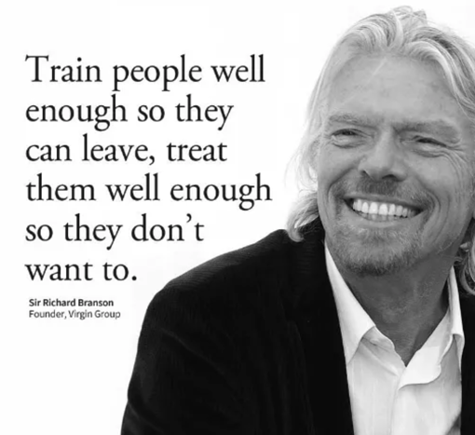

Slide 20
EMPLOYEE RETENTION
Notes:
Cost of attrition -Days spent in recruitment and training
Check on Attrition rate and cost of attrition
Make your brand personable and relatable
Give voice in scheduling, workflows, and hospital policies - Offer flexible schedules - Reducing overtime
Ensuring adequate staffing levels and supporting acuity-based staffing tools.
Safety at and after work – pick up and drop facility, safety for family members- staffs coming from containment zone in COVID affected regions.

