Slide 1
Quality Management Systems Role In Improving Efficiency & Reducing Costs
Ms. Sandhya Mahadevan General Manager (Admin & Quality Systems)
PRS Hospital Pvt. Ltd

Slide 2
Introduction
Quality is now being recognised and felt like never before !
Terms like “Safe Practices” , “Efficiency”, “ Cost
reduction” have suddenly gained new found meaning
and understanding.
“ Maximum utilisation of minimum resources” and “Minimisation of waste” has become the new mantra.
Accredited hospitals that have SOPs in place have an advantage over those that do not have. We ourselves have been sharing our HIC protocols with non accredited hospitals.

Slide 3
Role of NABH/QM system in improving process & managing challenges of Covid-19
QMS Element | Outcome – Efficiency / Cost Reduction
Quality and IPC team readily available to take over the crisis! | Infection Control and Quality suddenly become “The” most important and wanted departments !
With a QMS already implemented, safe protocols readily available and staff already trained. | Handwashing compliance almost 100 %
Effective and quick communication of new protocols during Covid | Implementation smoother and easier.
Budget for Quality and Infection Control , Contingency funds available | More resources at hand

Slide 4
Access & Accessibility
QMS Element | Outcome – Efficiency / Cost Reduction
Display of Awareness posters and Covid related guidelines | Updated as and when changes occur Eg – Only after 28 days after seeing his last patient, can a medical professional donate blood.
Safe Transport | Patient transporters provided with PPE , New patient transport routes within the hospital so that there is least exposure Ambulances sanitised after each transport, PPE for drivers & trained
Initial screening protocols before anyone gets into the hospital building One bystander / patient policy | Less foot fall, no artificial crowding. Less waste generated, less energy and water consumption
Face punching instead of biometric access for employees | Easier . Staff confidence increased.
Telemedicine introduced | Continuity of care ensured. Apt time to transit to new technology !
Staggered appointments for patients | Waiting time reduced . Social distancing maintained

Slide 5
Care Continuity
QMS Element | Outcome – Efficiency / Cost Reduction
Realised the importance of self sufficiency in lab testing | Acquired GeneXpert for Covid testing – (RT PCR) Being already NABL accredited, adding on a test by remote audit is easy
More demand from In patients for non A/c rooms | Electricity saved
During lockdown, when patient numbers were at 50 %, general wards shut and rooms allotted at general ward rates | Cost saving in terms of electricity, water and staff than to keep the general wards fully operational for minimal patient numbers
Entire process of patient discharge monitored through system and inter department communication through whatsapp groups for discharge process | Discharge time reduced.
Patient doubts and clarifications addressed through Dr D Better Life – a face book page and youtube by Dr. Danish, HOD, ER. | More than 1500 questions answered since March 2020 . More than 200 videos on Covid – 19 released.

Slide 6
Care of Patient
QMS Element | Outcome – Efficiency / Cost Reduction
All patient care protocols revised in view of safety precautions. | Eg, CPR members to wear PPE
More facilities for intensive & emergency care | ICU trained nursing staff, intensivists, emergency technicians, Consultants in Emergency Medicine, More ventillated beds
Fever Clinic | Fever Out patients segregated from the rest of patients.
Less physical contact with patient | Communicate more… Speak to the patient and express the concern and empathy
Protocols for non availability of beds | Not easy to refer patients to another centre.

Slide 7
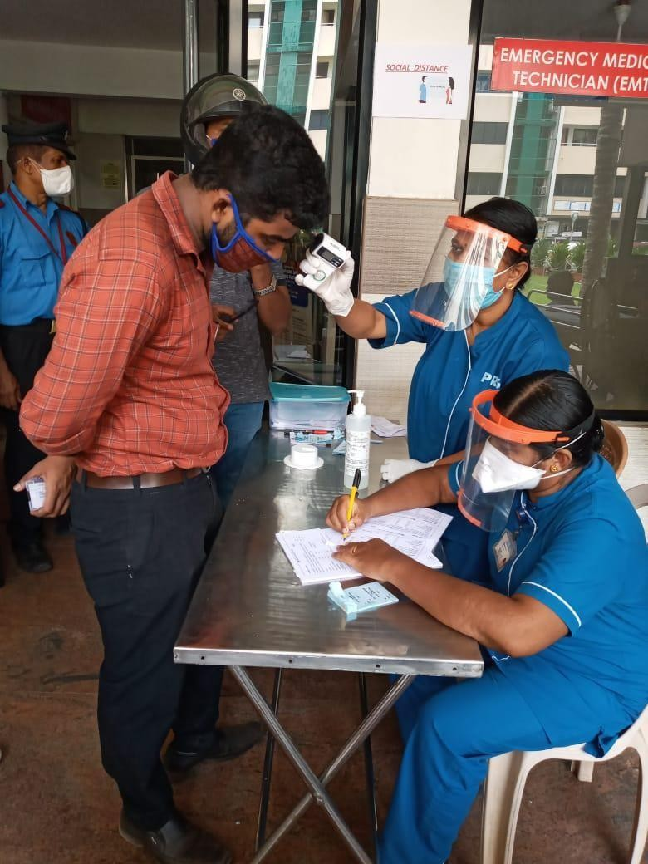
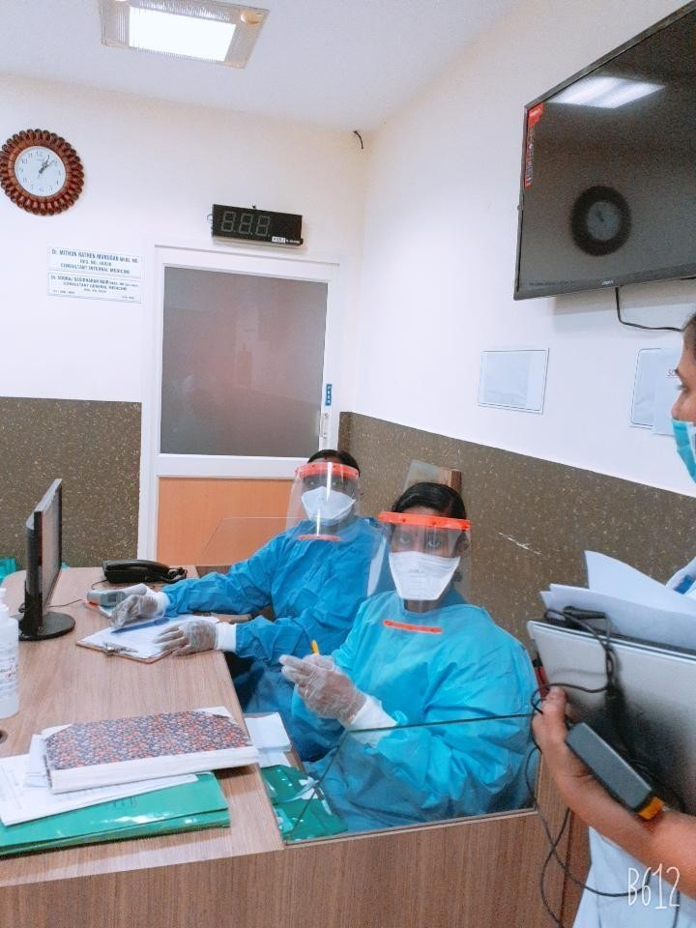
Initial Screening outside hospital building
Fever Clinic

Slide 8
Medication Management
QMS Element | Outcome – Efficiency / Cost Reduction
Stock of essential drugs and medicines increased and frequency of reorders decreased | No shortages Reserve list of PTC approved vendors
Disposables - Masks, gloves and sanitisers | Usage increased ! Started in house production of sanitisers and masks
Strictly not dispensing medicines without prescriptions, especially for cold, cough , fever etc. | Safe practices
Count down for the Covid vaccine and medicine

Slide 9
Patient Rights & Education
QMS Element | Outcome – Efficiency/Cost Reduction
Patient education on wearing masks, maintaining social distancing | Posters and handouts for social distancing etc. Stickers on lift floors etc Hand washing education for Inpatients and relatives Hand sanitiser for all visitors
Frequent Public Announcements reminding patients about Covid symptoms, handwashing and social responsibilities | More awareness
Online patient feed back | Less paper work. No more paper feedback forms.
Have a designated spokesperson to tackle media | Less dissemination of wrong information

Slide 10
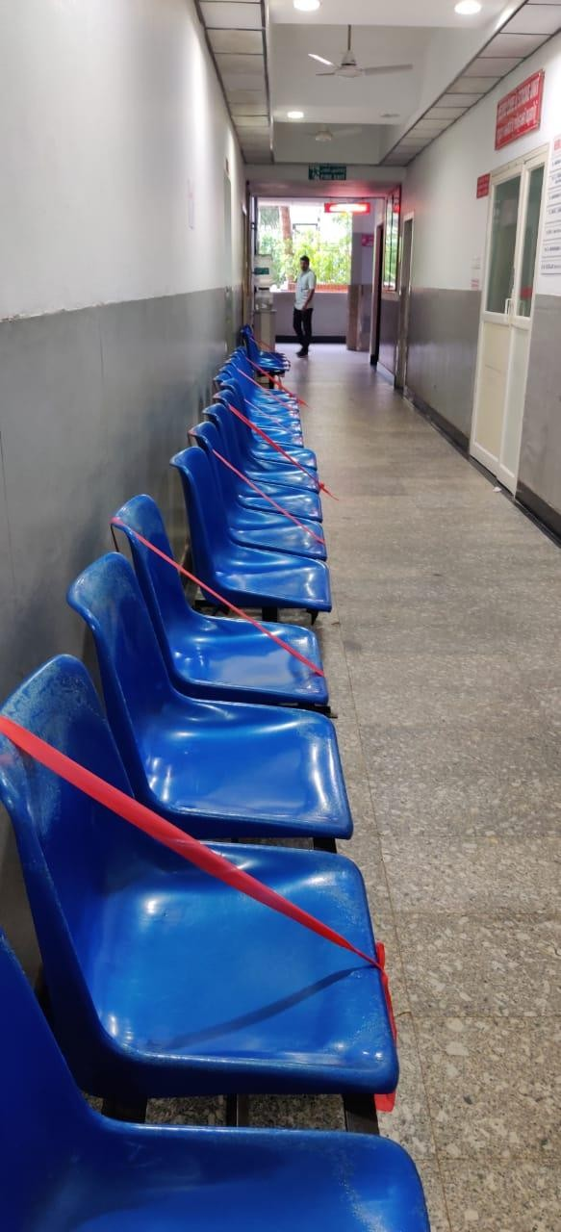
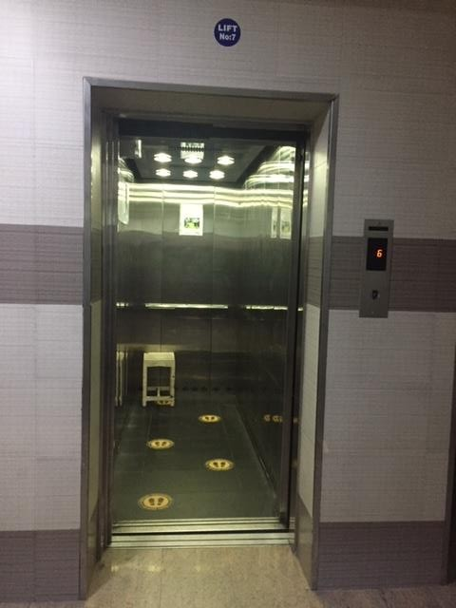
Ribbon and stickers to ensure social distancing

Slide 11
Hospital Infection Control
QMS Element | Outcome – Efficiency / Cost Reduction
Protocols for pandemics and epidemics assumed new significance | Realisation that these protocols are not mere documents and that these protocols are life saving
Statistics reporting to Government and authorities | Data management . Consider appointing a statistician !
Handwashing compliance | Near total compliance. Audit results are excellent Doctors are more compliant !
Activities towards prevention of community spread | Liberal donations to community groups Distribution of masks etc to police
Scaling up of Isolation facility and Infection Control practices | Compliance increased to near 100 % Isolations wards, Isolation ICU beds identified
Use of PPEs | Policing by Quality Department no longer needed ! A new problem has surfaced, Over use of masks, gloves and sanitisers !! Increase in total patient bill, but not claimable
Single use linen , body bags | Safer products

Slide 12
Patient Safety & Quality
QMS Element | Outcome – Efficiency/Cost reduction
“Safe” practices is the new watchword ! | The entire hospital will centred around safety solutions
Risk monitoring has become most dynamic | New risks being identified by staff and so are solutions for it, some very innovative too !
Designated Patient safety officer and Clinical safety officer | Clinicians will also now involve more in Safety related concerns

Slide 13
Management Responsibility
QMS Element | Outcome – Efficiency / Cost Reduction
Budgeting and Finances | Staff salaries deferred to ensure a “Reserve Fund “ Negotiations with suppliers for 50-75 % payment so that reserves are more
Resource Management | Purchases restricted to essential items. Stock of essential items ensured while JIT practiced for non essential items
Communication | All meetings made online – Time saved.
Time / Change Management | During initial stages of Covid, when surgeries were reduced to half, renovation of 2 super specialty OTs, undertaken. – Saved on revenue loss if done in ordinary times Hospital maintenance, repair etc done when patient numbers were less– Again saved on revenue loss Converted a general ward into an ICU

Slide 14
Facility Management
QMS Element | Outcome – Efficiency / Cost Reduction
All airconditioning units in waiting areas and office spaces shut down | Reduced electrical consumption
Online requests for maintenance / repair etc. | Turn Around Time Monitoring more accurate ! No registers , records . No paper !
Local vendors preferred over outstation vendors | Quick and immediate service
Centralised Purchase of common items for PRS Group concerns | Economies of Scale
In house Calibration | Reduced calibration costs

Slide 15
Human Resources
QMS Element | Outcome – Efficiency/Cost Reduction
Staff working in alternate schedules | Assured reserve staff during peak of the scare !
PF, TDS cuts reduced by Government | More cash in hand for staff to compensate for the deferred payment
Working together in crisis ! - Rope in staff of sister concerns ! | More power to the organisation ! Talent pool widened !
Pool the resources ! School/College buses of PRS Schools and Nursing Colleges used to transport hospital staff | Assured presence of hospital staff on time.
Acuity Based staffing | Staff allocation based on the requirement and experience
Multitasking of staff to tide over quarantine leave | New talents discovered ! HR discovered inhouse talent pool !
New topics for training | Eg, “high touch surfaces “ for housekeeping, Use of PPE kit

Slide 16
Information Management Systems
QMS Element | Outcome – Efficiency/Cost Reduction
Busy organising Zoom meetings and educating staff on online skills | Work efficiency increased, less time wasted and all meeting well planned. All hospitals have to move to a wi-fi environment.
Flooded with demands for transiting to online / system based record keeping from records / registers | Less stationery . Go Green !

Slide 17
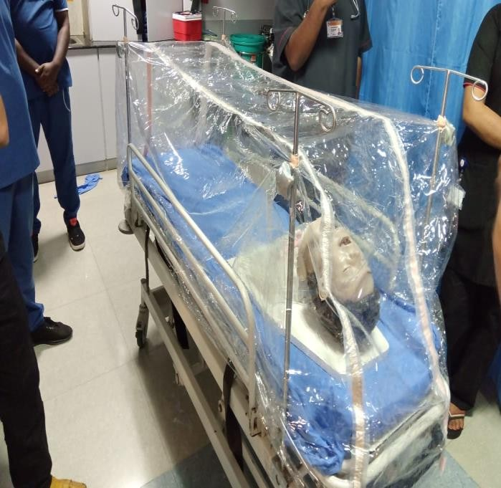
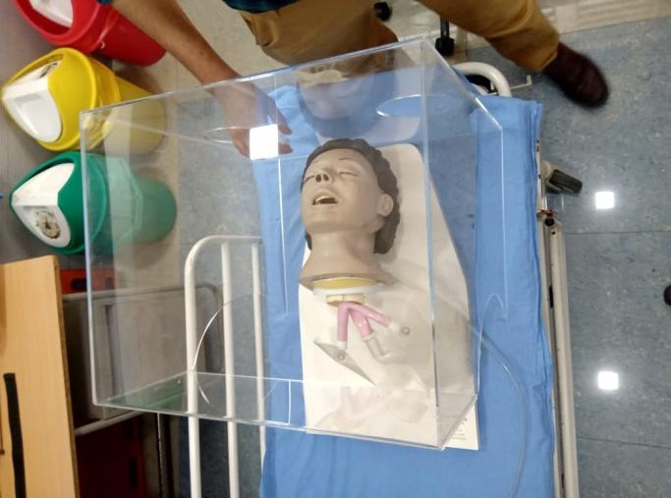
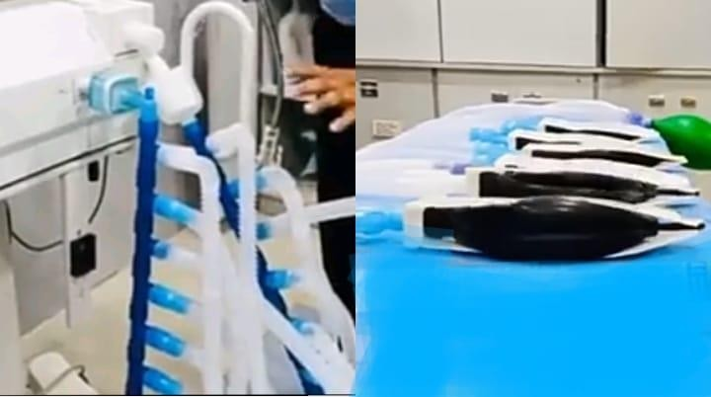
Covid Season In - house Innovations Creativity at its best !
OHP sheets as face shield
Patient hood for intubation
Patient transport hoods
Ventillator tubing connections rearranged so that one ventillator can deliver 4 patients for a future contingency situation

Slide 18
Post Corona Era –Preparing for the
next new normal…
More focus on healthcare and healthcare workers
Operational excellence – Cost effectiveness, scalability of services
Non contact services like AI, IoT
Virtual care of patient
Recognition of home care
Continued Surveillance - Data & Statistics
New habits to continue – Social distancing & handwashing
Diagnostics, testing & screening outside hospitals at standalone labs
Increased retailing of pharmacy

Slide 19
If not already quality accredited, go for it !
It is the need of the hour !

