Slide 2
In the present health care scenario, increasing operational efficiency and reducing costs, while improving service provided to the patient are a constant challenge.

Slide 3
What does Equipment Utilization Means
The extent to which the productive capacity of an equipment is used during a specified period of time and can be expressed in percentage (%).
Utilization = Recorded time of Actual working time / Available time

Slide 4
Why Equipment Management is Important
Era of cost intensive Medicare
Demand for improved diagnostic facilities
Sophisticated equipment with modern technology
Medical devices are assets that directly affect human lives
They are considerable costly investments
Equipment maintenance program keep the hospital equipment in a reliable, safe and available for use when it is needed
Such a programme prolongs the useful life of the equipment and cost effective
To optimize utilization to obtain maximum return for capital invested
Better utilization results in quick “Break-even-point”
Optimal patient handling and rapid turn over minimizes cost
Quality patient care, Safety and satisfaction

Slide 5
Benefits
Greater Safety
Decreased Production Down Time
Fewer large Scale & Repetitive Repairs
Less Cost for Simple Repairs
Less Standby Equipment Required
Better Spare parts Control
Proper Identification f Items

Slide 6
Challenges
The Challenges involved in hospital equipment management are the following:
Longer downtime of equipment. (Period of time that a system fails to provide or perform its primary function).
Hospital administrator’s inadequate knowledge on importance on routine hospital equipment maintenance and service.
Absence or little budgetary support for maintenance.
The lack of the framework for regular auditing system.

Slide 7
Lack of knowledge and innovative ways of using new equipment.
Delayed fault reporting, example BP Apparatus patch up with plaster.
The difficulty in obtaining spare parts.
Failure to provide technical training to operators.
Obsolete equipment left unattended in maintenance room and wards.
The absence of evidence-based information system on health care technology for decision making.

Slide 8
Medical Equipment
Non-Medical / Facility Engg Equipment
IT Equipment

Slide 9
The hospital medical equipment management is a management cycle that’s starts from
- Planning
- Procurement
- Acquisition
- Installation
- Commission
- De-commission & Disposal
EQUIPMENT MANAGEMENT PROGRAM
Equipment Management program Starts from
procurement and end at condemnation and disposal
EQUIPMENT MANAGEMENT
PROCUREMENT
CONDEMNATION

Slide 10
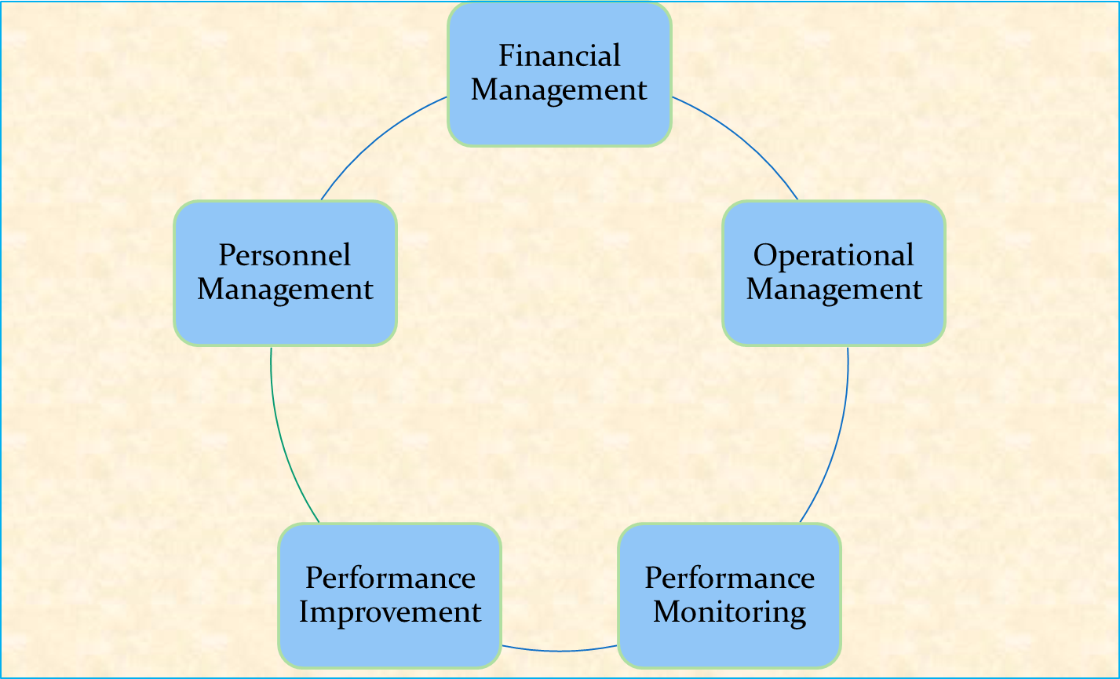
MANAGEMENT

Slide 11
Financial Management
*Monitoring cost
*Managing the budget
Personnel Management
*To provide support to the maintenance program so that program objectives are achieved
Service Vendors
*Equipment manufactures
*Independent service organizations

Slide 12
Operational Management
SOP’s
IPM FREQUENCY
PRIORITIZATION
OPERATIONAL MANAGEMENT
USE AND USER ERROR
COMMUNICATION
CMMS
LOG BOOK

Slide 13
Operational management consists of
Proper design and installation of equipment
Equipment control & Asset management
Effective predictive / preventive maintenance program
Repetitive servicing and overhaul of equipment
Work Order Management

Slide 14
Periodical calibration of equipment and measuring instruments
Adequate lubrication, cleaning and painting
Lowering breakdowns
Data Quality Management
Route cause analysis
Proper corrective action program
Quality assurance program
Patient Safety
Risk Assessment

Slide 15
Components of a Maintenance Programme
Maintenance
IPM
Corrective maintenance
Inspection
Preventive Maintenance

Slide 16
Equipment Management Programme
An effective medical equipment management programme consists of
PLANNING
IMPLEMENTATION
MANAGEMENT

Slide 17
Predictive maintenance
Preventive maintenance
Routine maintenance
Planned maintenance
Breakdown maintenance or corrective maintenance

Slide 18
Objectives
Minimize loss of productive time
Minimize repair time & cost
Keep productive assets in working condition
Minimize accidents and safe operations
Minimize total maintenance cost
Improve quality of products & outcome

Slide 19
Importance
Dependability of service
Assured quality
Prevent equipment failure
Cost control
Huge investment in equipment & ROI in acceptable time frame.

Slide 20
Predictive Maintenance
In this, sensitive instruments (eg. vibration analysers, amplitude meters, audio gauges, optical tooling and resistance gauges) are used to predict trouble. Conditions can be measured on a continuous basis and this enables the maintenance people to plan for an overhaul.

Slide 21
Preventive management
It is undertaken before the need arises and aims to minimize the possibility of un -anticipated production interruption or major breakdowns. Usually carried out by in-house resources Scheduling and strict monitoring Keeping critical spares inventory is essential Helps to minimize downtime, service continuity and reduce expenditures on maintenance of equipment

Slide 22
Routine maintenance
This includes activities such as
Periodic inspection - daily visual checks
cleaning
Lubrication
Calibration of measuring instruments

Slide 23
Planned maintenance
It involves the inspection of all plant and equipment, machinery, buildings according to a predetermined schedule in order to service overhaul, lubricate or repair, before actual break down or deterioration in service occurs.
Half yearly & Yearly maintenance

Slide 24
Breakdown Maintenance
Occurs when there is a work stoppage due to equipment breakdown
Maintenance becomes repair work
Seeks to get the equipment back into operation as quickly as possible
To control the investment in replacement / spare equipment.

Slide 25
Maintenance Scheduling
Scheduling refers to timing and sequences of operations.
It is an important segment of the equipment utilization & control activity as well as the service operations like equipment maintenance

Slide 26
Importance of scheduling
Facilitates optimum use of highly paid maintenance staff
Equipment can be utilized effectively
Eliminates undue interruptions in the service flow
Eliminates chances of sudden breakdown
Facilitates proper sequence in maintenance service

Slide 27
Training
For the safety of the patient and the user, proper training is
critical for both the user and the technical staff.
Self – Study:
Reading the equipment service and training manuals
Using additional self-study materials provided by the manufacturer
Using materials provided by a third party.
One-to-one training provided by a more experienced person from inside the organization
Manufacturer's training programs.
Specifically designed for equipment technicians and provided by the Indian agent

Slide 28
Condemnation
Completed life time (7 to 10 years) Electronic equipemets
Beyond economic repair (BER)
Non functional and obsolete
Functional and obsolete
Functional but hazardous
Procedure / documents required for condemnation.
1) History sheet
2) Recommendation of maintenance Committee
3) Condemnation committee recommendation to HOD
4) Approval of competent authority for disposal and right off.

Slide 29
Issues
How much maintenance is needed?
What size maintenance crews must be used?
Can maintenance be sub-contracted?
Should maintenance staff be covered by wage incentive schemes?
Can effective use be made of computers for analyzing and scheduling activities?

Slide 30
Control of EMP
Authorized by an official
Maintenance schedule
Issue materials against proper authorization
Maintenance budgets
Equipment records

Slide 31
Performance Monitoring and Measurements
Availability=Total available hours – Total breakdown hours
-----------------------------------------------------
Total available hours
MTBF = Total available hours – Breakdown hours
--------------------------------------------------
Number of breakdown
MTTR = Total breakdown hours
----------------------------
Number of breakdowns

Slide 32
Service Contract
TYPE OF SERVICE | FREQUANCY | COST
AMC | Internal Staff provides initial response. External staff follows up as when required. At least four visit a year | Fixed Charges Only service provided Renewed ever year
CMC | Varying response time available as needed | CMC charges service , minor spares and consumables free
Full Service With Parts (WARRANTY) 5 to 10 Years | Quick response available at all times for maintenance and repair | Fixed Charge parts to be provided on payment

Slide 33
Several healthcare institutions out source equipment management and facility services
Major equipment under AMC / CMC with OEM
Appropriate and qualified service vendor selection
Control mechanism to be developed to ensure effectiveness of service contract program (SLA-Service level agreement)
Usually a nodal person identified to manage equipment service program

Slide 34
Conclusion
To ensure optimum utilization of equipment,
continuity of patient care with greater quality
at reduced cost, it is imperative for health care
facilities to have a effective equipment
management system.

