Slide 1
Branding - Gaining Public Confidence during COVID times
Harish Manian
MGM Healthcare

Slide 2
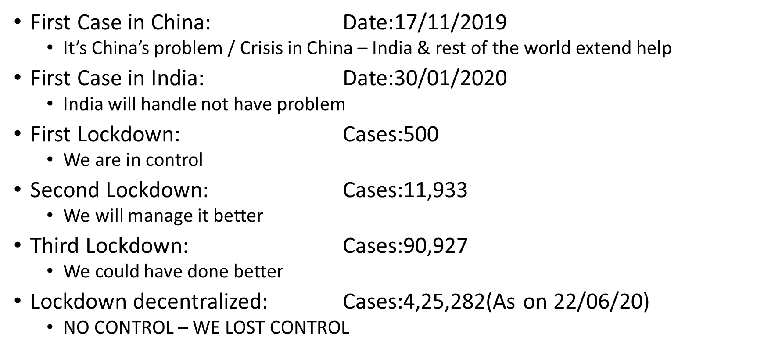
Chronology of COVID-19

Slide 3
How situation unfolded
March 2020: (Nothing to worry)
Everything will be alright in 15 days and cases will be under control
April 2020: (This will pass)
BOOMING Tech platforms
Newspapers to Food to Grocery to Gaming to OTT
Shift in Focus towards Healthcare
Govt and Agencies understood the need
Healthcare: Selected hospital in City / Medical Schools start admission
Healthcare: Only Emergency / Elective Work completely dry
May, 2020: (Delhi / Mumbai / Chennai – IPL starts)
Cases surge – Partial lockdown
Many industries (Manufacturing / IT / Construction) starts crawling back
Healthcare – More participation from Pvt. City hospitals
Healthcare: Elective work starts happening / COVID admission starts
June, 2020: (Lost control… States take control)
Airlines start operating
Trains start operating
Manufacturing starts in phases
Healthcare : Almost all hospitals starts taking COVID admissions.
New Healthcare mix: Emergency / Elective / COVID

Slide 4
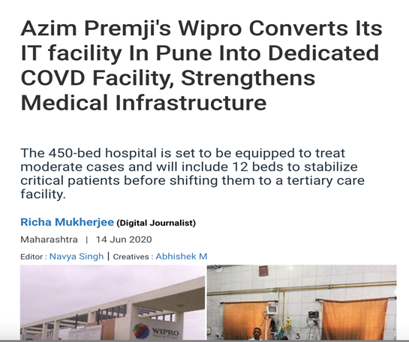
What industry did
Humanitarian / Healthcare Crisis
Economic Crisis
FOCUS
CONSERVE
FOCUS
CONTRIBUTE

Slide 5
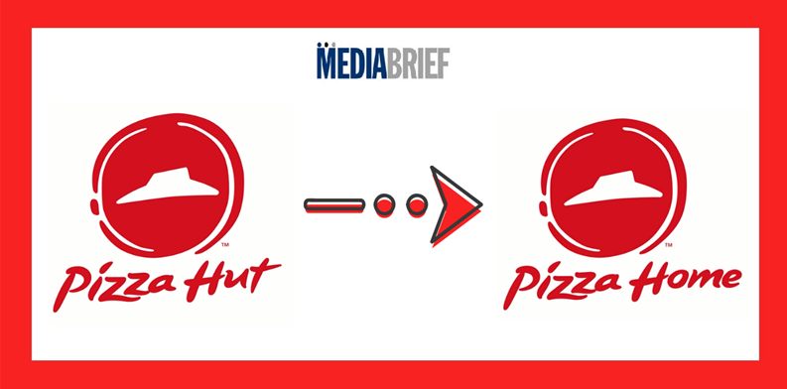
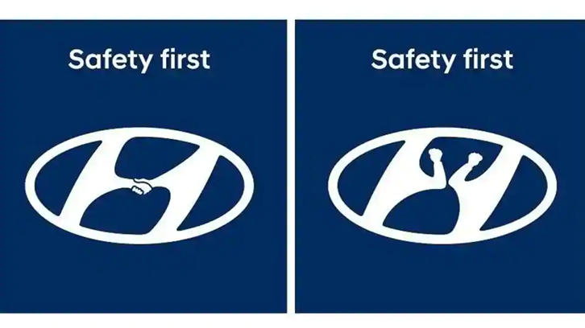
How Brands Behaved

Slide 6
What happened in Healthcare
Healthcare also like other industries went into still-waters
Phase 1
No-work
Phase 2
Emergency / Part Elective Work starts
Phase 3
OP volumes getting back to 3 digits
Only Emergency
Occupancy dropped to double digits / OP vol. in double digits
Foot Falls pick-up
Some Hospitals start talking COVID admissions
IP volumes pick up
Emergency / Elective / COVID – starts to co-exist
March-April 2020
April-May 2020
May-June 2020

Slide 7
How customer adapted ?
Very high uptake of technology
Slow Tech – Hyper Tech (In Healthcare & Otherwise)
Tele-consultation
Robotics
Thermal Imaging
Contact-less services
Discouraged hospital visits
Only Emergency
Unavoidable medical needs
Home Health
Look for non-COVID / hygienic / Safe Hospital

Slide 8
Changing Branding focus
Socially Responsible
Build Trust
Re-Position & Re-Calibrate
Innovative Brand Comm
Traditional Branding: in Healthcare Context
A brand makes intangible, tangible
COVID_IFIED
From talking about 3T MRI….. How 3T MRI is cleaned
From Surgery (CABG / TKR / PTCA)….. To Infection Control (OT / ICU)

Slide 9
Current Brand strategy
Brand gives life to Logo: Adds character
Trust / Confidence / Reliability / Tangible
PRODUCT FOCUS to SERVICE FOCUS
Feeling a Car to buy a car online
Food Delivery: Focus on person delivering food to food itself
256 Slice CT to How CT is clean
TANGIBLE TO INTANGIBLES

Slide 10
Healthcare Business Segments
ROI
Local
With restriction on international Travel focus will be intense towards Local / hyper Local and Rest Of India Business
Local +
ROI
Local
International
Traditional Matrix for Healthcare in India: Branding was also focused on all the segments
International Business has to be compensated by Domestic and Local footfalls
Every Brand will focus on neighborhood and regional markets

Slide 11
Where are we in the Brand cycle?
COVID HAS MADE A LEVEL PLAYING FIELD
THE KEY WILL BE HOSPITALS POSITIONING AND PROMISE

Slide 12
New Normal – Old Normal
MOST OF THE HOSPITALS HAVE HIGH OCCUPANCY.. BUT
MOSTLY MEDICAL MANAGEMENT – COVID UPTAKE
SURGICAL VOLUMES HAVE HALVED
CARDIAC INTERVENTIONS HAVE HALVED
ORGAN DONATION IS NEGLIGIBLE
ARPOB HAS HALVED
INTERNATIONAL BUSNESS NEGLIGIBLE
POSITION
REPOSITION PRODUCTS AND SERVICES
PROMISE
NEW WORKFLOW WHICH WILL PROMISE SAFETY AND OUTCOME
PERCEPTION
BUILD TRUST WITH ALL THE KEY STAKE HOLDERS TO ENHANCE FOOTFALLS

Slide 13
BUSINESS-RISK PROFILING OF HOSPITALS
SMALL FORMAT HOSPITALS – LOCAL & NEIGHBOURING FOCUS
BUSINESS: LOW RISK
OPERATION: HIGH RISK
MID SIZE HOSPITALS WITH LOCAL & REGIONAL FOCUS
BUSINESS: LOW / MEDIUM RISK
OPERATIONS: HIGH / INTERMEDIATE RISK
LARGE FORMAT HOSPITALS WITH LOCAL / REGIONAL / INTERNATIONAL FOCUS
BUSINESS: HIGH RISK
OPERATIONS: LOW RISK

Slide 14
Achieving the “old normal”
All branding initiatives will focus on local / Regional / Domestic business
Reposition some of the services
Pulmonology / Respiratory Medicine
Shifting customer loyalty – Crisis support
Level Playing field – 20yr of existence to 1yr of innovation
Amazing opportunity to showcase New talent / Clinical services
Talent shift during COVID period
Talent shift post COVID
Co-Branding and Collaboration opportunity
Healthcare and Non-Healthcare platforms

Slide 15
Its natures onslaught to recalibrate 3P’s (people, process & position) and re-invent 3D’s (Dedication, Determination & Decisiveness),
10 months of extreme-struggle will give 10yrs of wisdom & maturity. COVID will differentiate MEN among boys.. ☺

Slide 16
THANK YOU!

